Slide 1
Digital Portfolio
STUDENT NAME: Krishnakumar p
REGISTER NO AND NMID: 24134060500121026andasanm40624134060500121026
DEPARTMENT: BCA
COLLEGE: COLLEGE/ UNIVERSITY:Dharmapuram Adhinam Arts College,
Affiliated Annamalai University

Slide 2
PROJECT TITLE
*creative Student Portfolio Using FWD

Slide 3


AGENDA
Problem Statement
Project Overview
End Users
Tools and Technologies
Portfolio design and Layout
Features and Functionality
Results and Screenshots
Conclusion
Github Link
3/21/2024 Annual Review

Slide 4

PROBLEM STATEMENT
A digital portfolio provides an interactive and accessible platform to perform to perform achievements, skills and experiences

Slide 5

PROJECT OVERVIEW
The aims to empower students and young leaders with the skills, knowledge and confidence to become innovation problem-solves and change-makers.The project focuses on developing leadership qualities, fostering creativity and promoting social responsibility

Slide 6

WHO ARE THE END USERS?
*Students(projects, resumes) *Job seekers(career counseling) *young professionals(leadership skills)

Slide 7

TOOLS AND TECHNIQUES
#HTML-->Structure #Css-->Styling #JS-->Interactivity

Slide 8
POTFOLIO DESIGN AND LAYOUT
*Home/About Me *project *skills *contact *Responsive layout
8

Slide 9
FEATURES AND FUNCTIONALITY
*Navigation bar-with smooth scrolling *project showcase with image/ details *contact form(validation) *Responsive design for all devices

Slide 10
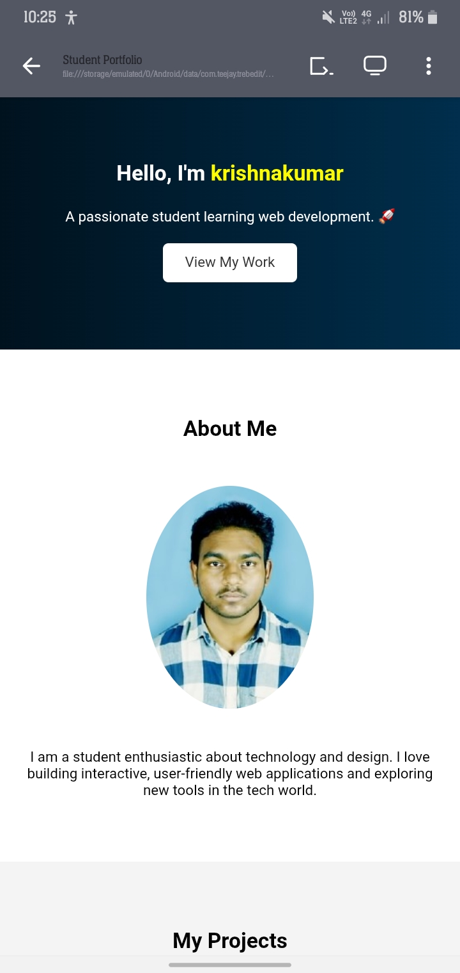

RESULTS AND SCREENSHOTS
3/21/2024 Annual Review
10

Slide 11
CONCLUSION
The project has been a resounding success, empowering students and young leaders with the, knowledge and confidence to become innovation problem -solvers and change makers.
11

